Slide 1
Big Sell 3rd October 2012 CONSORTIA AND COLLABORATION
Maggie Jones
Children England

Slide 2
DfE Overarching Strategic Partnership
Information exchange
Learning resources and sharing best practice
Events and peer networks,
Supporting organisations to learn from each other
Improve sustainability and explore the potential for growth from new forms of finance including;
public sector commissioning, and
building consortia and developing entrepreneurial ways of doing business.
Aims
To support the evolving economy and infrastructure of the whole voluntary, community and social enterprise sector serving children, young people and families.
To ensure a two way exchange between the sector and the Department in developing policy.

Slide 3
Collaboration: The wider context
Localism provides a key policy driver, which an increasing number of commissioners value
The Social Value Act: will enable smaller organisations to compete on a more equal basis
The extent of cuts requires radical service models, not just less of the same
High levels of uncertainty and churn - difficult to anticipate demand and funding streams
Move to bigger contracts with economies of scale for commissioners
Driving down price and passing over risk to supply side
Notes:
1.– working in partnership with Community Matters, NAVCA, NCVYS, Race Equality Foundation, Social Enterprise Coalition, and Oxford Brookes University;
2. with the National Youth Agency, Social Enterprise Coalition, and the Young Foundation;
4– working in partnership with Children England, Contact A Family, Daycare Trust, The Fatherhood Institute, and Social Investment Business;
5– working in partnership with Family and Parenting Institute, Children England, and Action for Prisoners' Families.

Slide 4
Collaboration : Service context
New forms of service offer real opportunities to deliver collaboratively;
Two year old offer
Personalisation for disabled children and young people
Wrap around family support
The “Youth Offer”
Parenting support
Advice services

Slide 5
Collaboration: The VCS Context
It plays to our strengths
Requires trust when we are being pit against each other
Is one of the few positive options in a shrinking funding environment
Needs forward planning; do we have the time?
Provides new routes to:
Develop organisational capacity and workforce skills
Extend representation, voice and influencing
Strengthen networks and cost effective communication

Slide 6
Collaboration spectrum
ENCOUNTER WITH OTHER ORGANISATIONS | SHARING WITHOUT MERGING | MERGER
Alliances also Networks Forums Assemblies | Integrated service delivery Sharing ‘back office’ functions Co-location Joint venture (including joint service delivery; joint campaigning) Consortium tendering | Equal merger Acquisition Group structure
LOW | IMPACT ON ORGANISATIONAL BOUNDARIES | HIGH

Slide 7
Children England Activities to date:
Better Together
Merger guide
Support for trustees
Training and independent brokerage

Slide 8
Better Together
Two year development project supporting VCS consortia in the North East
Wide range of information and advice sessions , materials/case studies
Bespoke support to 5 consortia to be bid ready
Contribution to ACEVO consortium development toolkit.

Slide 9
Training and Brokerage
Exploring risks and benefits for partnerships within the VCS and cross sectors
Training on collaborative bidding
Developing the business case for consortia
Brokering and supporting consortia within/
across authority boundaries
Consortium of consortia at regional level
(North Yorkshire)

Slide 10
CONSORTIA
Mechanism for collaborative working
Buying / Selling/ Working together
Models:
Informal network : ad hoc contracting
One agency becomes the lead
Hub and Spoke:
either a new legal body is established to manage a contract
or an external non-delivering organisation takes the lead

Slide 11
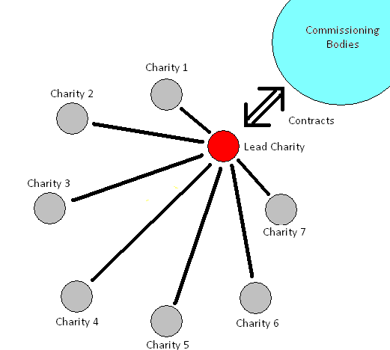
Lead Agency

Slide 12
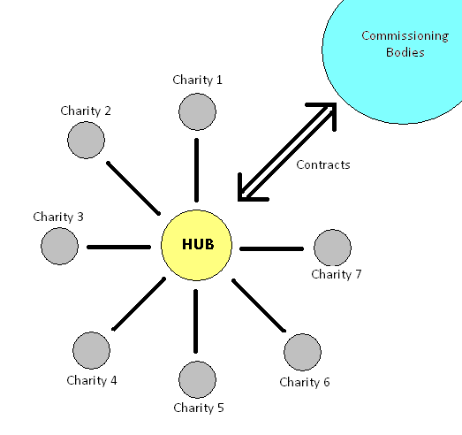
Hub and Spoke

Slide 13
What needs to be in place?
Clearly defined and shared aims
Business case / Strategic fit
Partner ownership
Good communication, feedback & review
Leadership
Roles/ responsibilities/ decision-making
Time and resources
Mutual trust & understanding

Slide 14
What gets in the way?
Fear
Personalities
Agendas (especially hidden ones)
Cultural differences
Capacity
Unwillingness to let go/ compromise

Slide 15
Challenges
VCS culture and history
Managing variation in quality, skills and expectations
Commissioning and procurement systems
Capacity – shrinking teams and resources for development
Time frames - trust takes time, bidding windows too short
Process hurdles – track record/ audit
Managing the work when you win it!

Slide 16
Opportunities
The whole being truly more than the sum of its parts
Flexible services for children, young people and families
Innovation; in services and partners
Scaling up
Skill sharing and mutual support
Cost savings : economies of scale
Securing niche services and groups
Spreading /sharing risk

Slide 17
Outcomes
Better services for children young people and families
Security and mutual support for the local sector
Collaboration triumphs over competition

Slide 18
www.childrenengland.org.uk

